Slide 1
Student Result Management System
Final Project EDGE

Slide 2
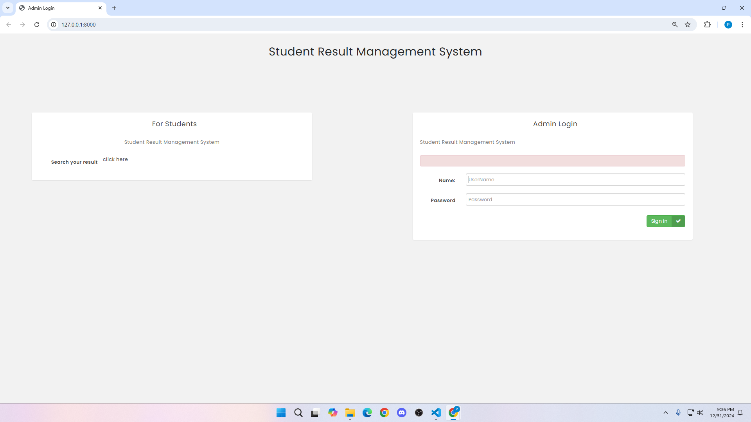
This is the home page

Slide 3
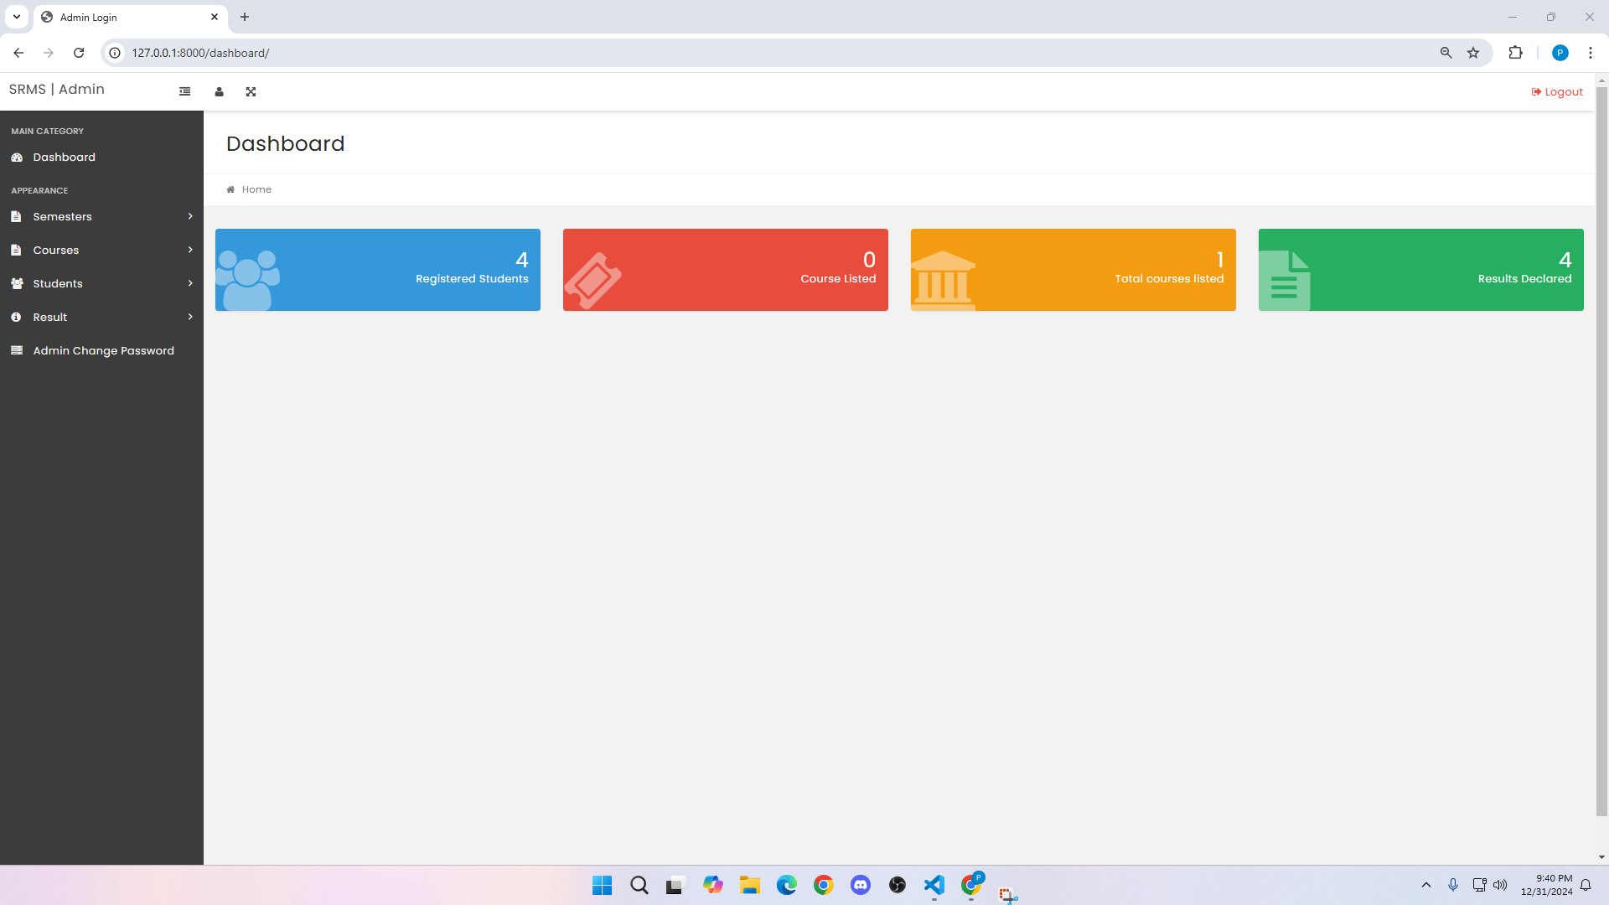
After Admin(teacher) login with id and password , this page will be shown

Slide 4
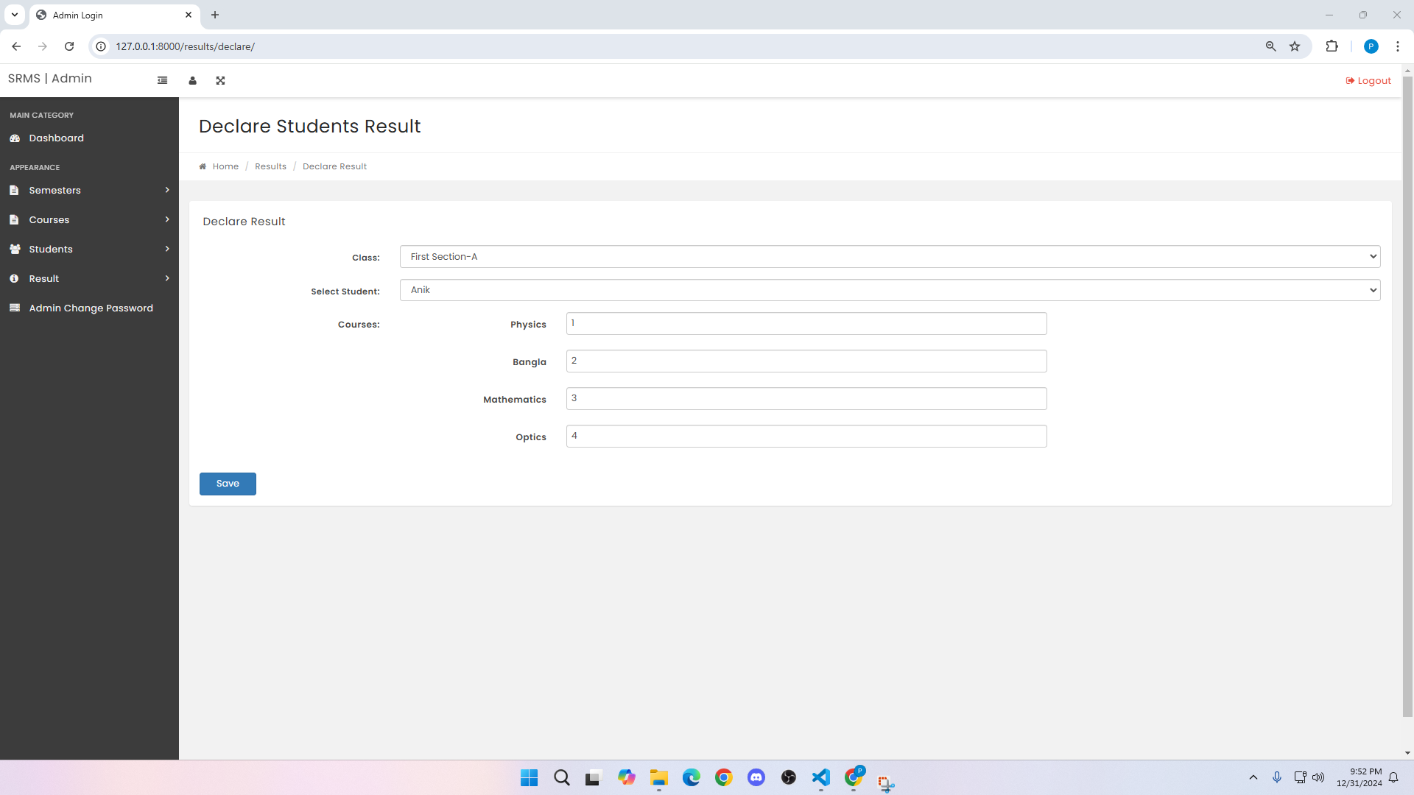
In the result section, admin can add new result

Slide 5
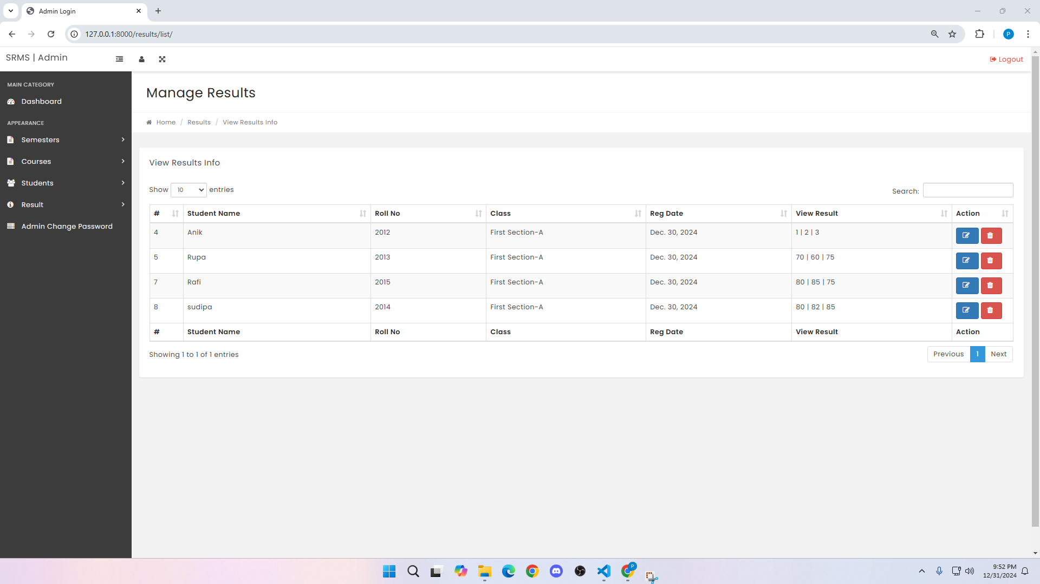
After adding result of a student , the total result will be shown in manage result section

Slide 6
Now for a student , first the homepage will look like this as before.

Slide 7
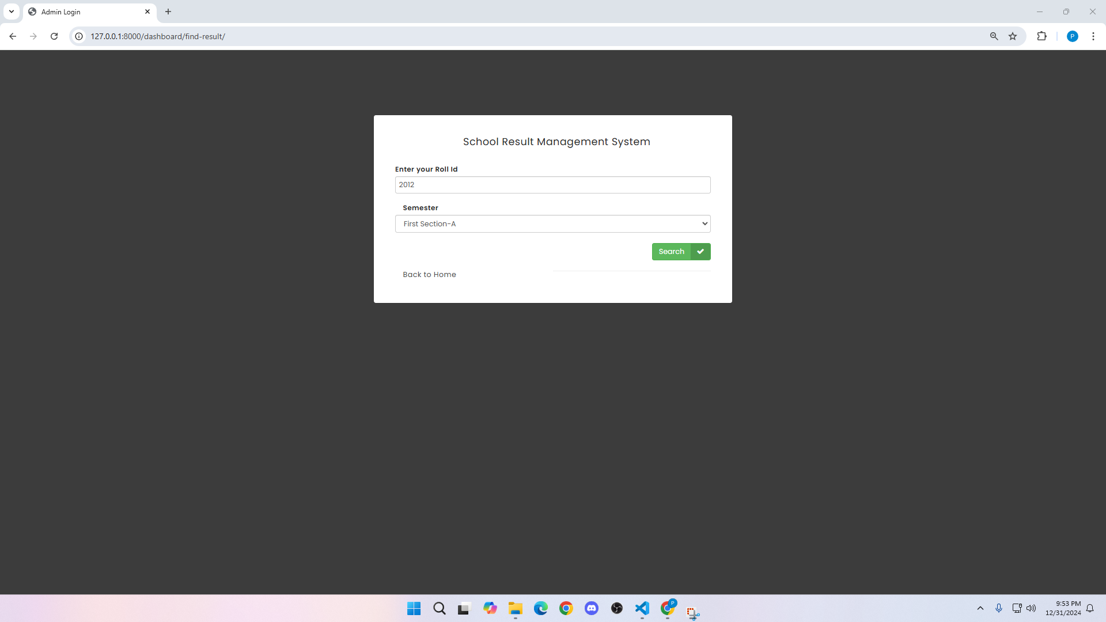
Then student will add roll and semester

Slide 8
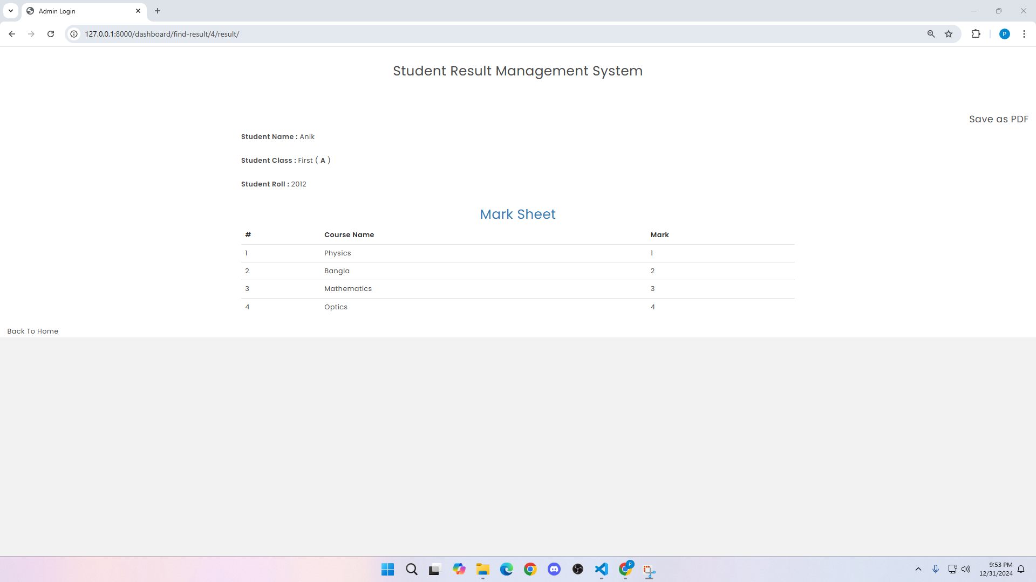
Now a student can see the individual result

Slide 9
THANK YOU

